Slide 1
LPS (Logic-based Production Systems)
Robert Kowalski and Fariba Sadri
Imperial College London
Miguel Calejo
Interprolog.com

Slide 2
Overview
Introduction
What is LPS?
Logic programming
Production systems
LPS (Logic Production System)
LPS examples
LPS in relation to computer science
LPS implementation
Foundations of LPS and related work

Slide 3
What is LPS?
An open-source, web-based prototype.
LPS is a logic and computer language for
programming
databases
AI (intelligent agent) applications.
LPS includes
logic programming (as in Prolog)
production systems (as a model of human thinking).
LPS teaches
computational thinking
logical thinking
beliefs
goals

Slide 4
LPS bridges the gap between Computational and Logical Thinking
Algorithms using
state transitions
Abstraction
Goals and beliefs
Problem decomposition
by backward reasoning
Forward reasoning to
derive logical consequences
Computational
thinking
LPS
Logical
thinking

Slide 5
Short History of Logic Programming
1969 – 72 Procedural versus logical representations in AI
1971 – 72 Prolog - the first Logic Programming Language
1980s Datalog
Logic as a Computer Language for Children
The British Nationality Act as a Logic Program
The Fifth Generation Project chooses Logic Programming
1990s – 2000s AI and Logic Programming in decline
beliefs
goals and
beliefs
2010s Resurgence of
Logic Programming
LPS

Slide 6
Fifth generation computer
From Wikipedia, the free encyclopedia
The Fifth Generation Computer Systems [Present and Beyond] (FGCS) was an initiative by Japan's Ministry of International Trade and Industry, begun in 1982, to create a computer using massively parallel computing/processing. It was to be the result of a massive government/industry research project in Japan during the 1980s. It aimed to create an "epoch-making computer" with supercomputer-like performance and to provide a platform for future developments in artificial intelligence.
The target defined by the FGCS project was to develop "Knowledge Information Processing systems" (roughly meaning, applied Artificial Intelligence). The chosen tool to implement this goal was logic programming.

Slide 7

Resurgence of Logic Programming
Design and Implementation of the LogicBlox System
Molham Aref Balder ten Cate Todd J. Green Benny Kimelfeld Dan Olteanu
Emir Pasalic Todd L. Veldhuizen Geoffrey Washburn
LogicBlox, Inc. 2015
A major goal of our system is to unify the programming model for applications that automate and enhance decision making by using a single, expressive, declarative language that can be used by domain experts to understand and evolve the application.
To achieve this goal, we have developed LogiQL, an extended form of Datalog that is expressive enough to allow coding of entire applications (including queries and views; stored procedures; reactive rules and triggers; and statistical and mathematical modeling).
But already today, the LogicBlox platform has matured to the point that it is being used daily in dozens of mission-critical applications in some of the largest enterprises in the world, whose aggregate revenues exceed $300B.

Slide 8
Resurgence of Logic Programming
Yedalog: Exploring Knowledge at Scale
Brian Chin1, Daniel von Dincklage1, Vuk Ercegovac1,
Peter Hawkins1, Mark S. Miller1, Franz Och,
Christopher Olston1, and Fernando Pereira1
1 Google, Inc. 2015
Abstract We introduce Yedalog, a declarative programming language that allows programmers to mix data-parallel pipelines and computation seamlessly in a single language. ….Yedalog extends Datalog, incorporating not only computational features from logic programming, but also features for working with data structured as nested records.

Slide 9
PageRank in Yedalog. Assumes the existence of Node and Edge predicates that describe a directed graph.
# The random jump probability.
Alpha = 0.15;
# Number of outlinks for every node.
Outlinks(j) += 1.0 :- Edge(j, _i);
# The (non-normalized) PageRank algorithm.
PageRank(i) += Alpha :- Node(i);
PageRank(i) += PageRank(j) * (1.0 - Alpha) / Outlinks(j) :- Edge(j, i);

Slide 10
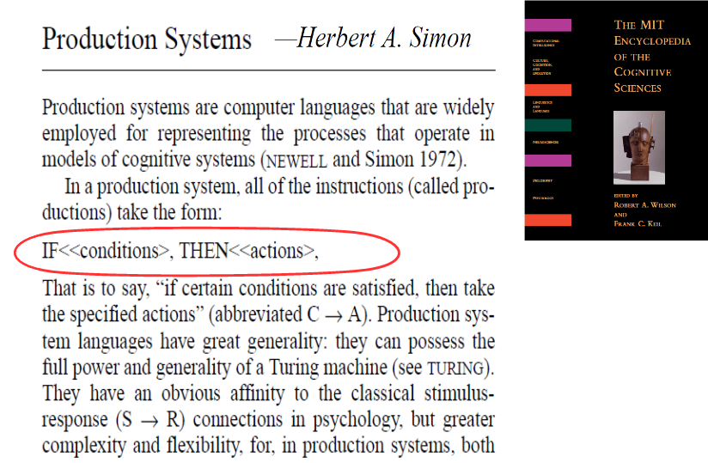

Slide 11
Production systems
beliefs
States described by a working memory of facts.
State transitions represented by condition-action rules.
goals
Popular
for implementing expert systems
as a computational model of human thinking
(e.g. SOAR, ACTR, Steven Pinker’s How the Mind Works)

Slide 12
Production systems do not have a logical semantics.
fire ⇒ deal-with-fire
deal-with-fire ⇒ eliminate
deal-with-fire⇒ escape
Adding fire to working memory.
Triggers two candidate actions eliminate and escape.
Conflict resolution decides between them.

Slide 13

Production systems.
Goals and Beliefs - It can be hard to tell them apart.
production
rules
logic
“Rules are if-then structures...
very similar to the conditionals...
but they have very different
representational and computational properties.”

Slide 14
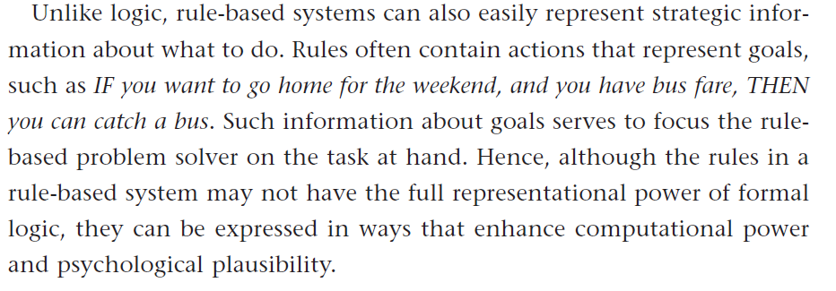

Goals and beliefs
It can be hard to tell them apart
Logic Program:
You go home from T1 to T2
if you have the bus fare at T1,
you catch a bus from T1 to T2,
the bus arrives at T2.

Slide 15
Goals and Beliefs:
It can be hard to tell them apart.
All humans are mortal.
All humans are kind.
Goals: if human(X) then mortal(X).
if human(X) then kind(X).
or
Beliefs: mortal(X) if human(X).
kind(X) if human(X).

Slide 16
LPS combines reactive rules, logic programs and causal laws
goal
Reactive rule: if fire then deal-with-fire.
Logic program: deal-with-fire if eliminate.
deal-with-fire if escape.
beliefs
Causal law: eliminate terminates fire.
Adding fire to the current state.
Generates two alternative actions eliminate or escape.
Generates alternative world models
to make the reactive rule true:
eliminate
escape
escape
Q
fire
or
fire
fire
fire

Slide 17
World models are sequences of states, actions and external events, described by atomic sentences (Herbrand models)
without time stamps
for efficiency
States are sets of facts (or fluents):
fire
Events (including actions) cause state transitions:
eliminate
with time stamps
for logical semantics
fire(10:15)
eliminate(10:15, 10:16)

Slide 18
The syntax of LPS
Reactive rules in First-order logic:
for all X [ antecedent → there exists Y consequent]
or if antecedent then consequent.
Clauses in logic programming form.
for all X [there exists Y conditions → conclusion]
or for all X, for all Y [conditions → conclusion]
or conclusion if conditions.

Slide 19
The syntax of LPS
without time stamps
for readability
Reactive rules:
if fire
then deal-with-fire.
Logic programs:
deal-with-fire
if eliminate.
with time stamps
for logical semantics
if fire at T1
then deal-with-fire fromT2 to T3, T1≤ T2.
deal-with-fire from T1 to T2
if eliminate fromT1 to T2.

Slide 20
State transitions are described by programmable causal laws
Postconditions (effects):
ignite(Object) initiates fire if flammable(Object).
eliminate terminates fire.
An emergent property,
not used to generate or query states.
Preconditions (constraints):
false eliminate, fire, not water.
Persistence (inertia):
A fact/fluent persists from the time it is initiated to the time it is terminated.

Slide 21
The logical nature of LPS
Computation generates a model of the world
described by logic programs
to make reactive rules true.
The imperative nature of LPS
Computation generates commands
to perform actions
to change the world
to make consequents true
whenever the antecedents of reactive rules become true.

Slide 22
LPS: Computation generates actions to make reactive rules true
Actions
The current state is updated
destructively
Forward
reasoning
Actions are
chosen and
combined with
external events
Reactive rules whose conditions are true
are triggered.
Logic programs
reduce goals to
subgoals and actions
Backward
reasoning
External events

Slide 23
The Operational Semantics of LPS is Incomplete
It cannot preventively make rules true
by making antecedents false:
if attacks(X, me) from T1 to T2, not prepared-for-attack(me) at T2 then surrender(me) from T2
It cannot proactively make rules true
by making consequents true before antecedents become true:
if enter-bus(me) from T1 to T2
then have-ticket(me) atT2.

Slide 24

The explicit representation of time and causal laws facilitates the treatment of concurrency

Slide 25
% dining philosophers
fluents available(_).
actions pickup(_,_), putdown(_,_).
initially available(fork1), available(fork2), available(fork3), available(fork4), available(fork5).
philosopher(socrates).
philosopher(plato).
philosopher(aristotle).
philosopher(hume).
philosopher(kant).
adjacent(fork1, socrates, fork2).
adjacent(fork2, plato, fork3).
adjacent(fork3, aristotle, fork4).
adjacent(fork4, hume, fork5).
adjacent(fork5, kant, fork1).

Slide 26
if philosopher(P)
then dine(P) from T1 to T2.
dine(P) from T1 to T3 if
adjacent(F1, P, F2),
pickup(P, F1) from T1 to T2,
pickup(P, F2) from T1 to T2,
putdown(P, F1) from T2 to T3,
putdown(P, F2) from T2 to T3 .
pickup(P, F) terminates available(F).
putdown(P, F) initiates available(F).
false pickup(P, F), not available(F).
false pickup(P1, F), pickup(P2, F), P1 \= P2.

Slide 27
What happens if we replace:
dine(P) from T1 to T3 if
adjacent(F1, P, F2),
pickup(P, F1) from T1 to T2,
pickup(P, F2) from T1 to T2,
putdown(P, F1) from T2 to T3,
putdown(P, F2) from T2 to T3.
with:
dine(P) from T1 to T5 if
adjacent(F1, P, F2),
pickup(P, F1) from T1 to T2,
pickup(P, F2) from T2 to T3,
putdown(P, F1) from T3 to T4,
putdown(P, F2) from T4 to T5.

Slide 28
LPS includes composite event recognition
if possible fire detected at T then respond to possible fire from T
possible fire detected at T if
heat-sensor detects high temperature in area A at T1,
smoke detector detects smoke in area A at time T2,
|T1 – T2 | ≤ 60 sec ∧ max(T1, T2, T)
respond to possible fire at T if
activate sprinkler in area A at T3, T < T3 ≤ T + 10 sec,
send security guard to area A at time T4, T3 < T4 ≤ T3 + 30 sec
respond to possible fire at time T if
call fire department to area A at time T5, T < T5 ≤ T + 120 sec

Slide 29
Overview
Introduction
LPS examples
LPS in relation to computer science
LPS implementation
Foundations of LPS and related work

Slide 30
Overview of the Tutorial
Introduction
LPS examples
LPS in relation to computer science
Declarative representations have the frame problem
Imperative representations perform destructive
state transitions without a logical meaning
LPS implementation
Foundations of LPS and related work

Slide 31
The Problem: Two kinds of system with no obvious relationship:
Logic-based systems (declarative)
State transition systems (imperative)
The Solution: Reactive rules and logic programs
Computation generates a model of the world
described by logic programs (beliefs),
to make reactive rules (goals) true.

Slide 32
Declarative systems
if A then B means if A is true then B is true.
Programming
Logic programing
Functional programming
Databases
Relational databases
Datalog
Artificial Intelligence
Knowledge representation
Causal theories, etc.

Slide 33
The Frame Problem
(lack of destructive state transitions)
e
Q
Q
e initiates q
e terminates p
p, u, v, w
q, u, v, w
time t
time t+1
It is necessary to reason that
u is true at time t+1 because u was true at time t
and u was not terminated from t to t+1.
v is true at time t+1 because v was true at time t
and v was not terminated from t to t+1.
33
w is true at time t+1 because w was true at time t
and w was not terminated from t to t+1.

Slide 34
The Problem: Imperative languages are natural and efficient, but do not have a logical meaning
if A then B means change of state. e.g.
If A holds then do B (imperative).
Programming
state charts
abstract state machines
Databases
active databases
Artificial Intelligence
production systems
agent languages
if A then B
does not have a logical interpretation.
States change destructively.

Slide 35
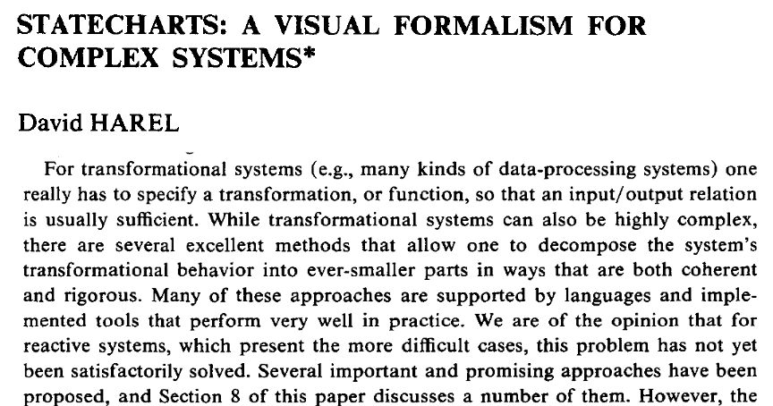

Two kinds of programming systems
e.g. logic programs
e.g. production systems

Slide 36
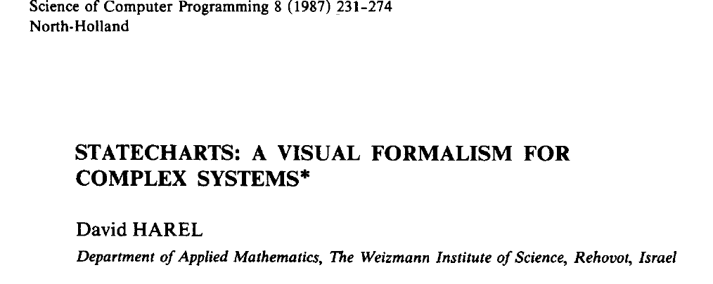
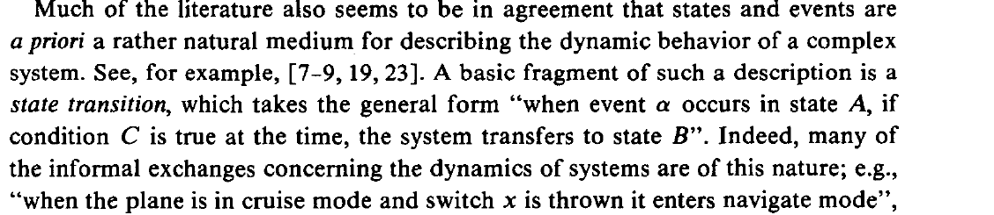
reactive rule

Slide 37
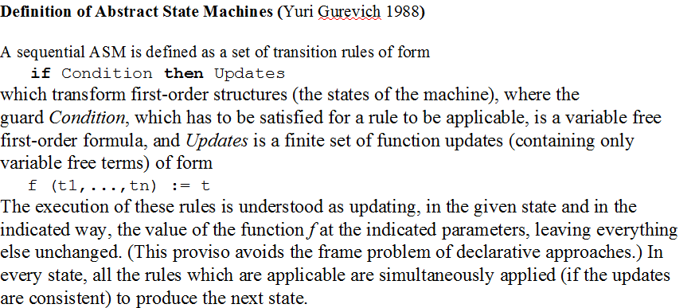

From Abstract State Machine Tutorial presented by Egon Börger
not logical
if-then

Slide 38
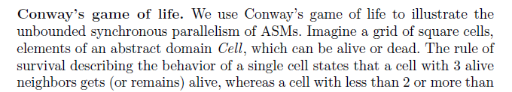
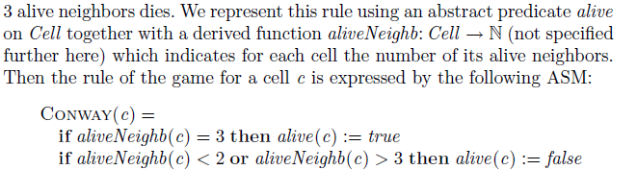
https://en.wikipedia.org/wiki/Conway%27s_Game_of_Life

Slide 39
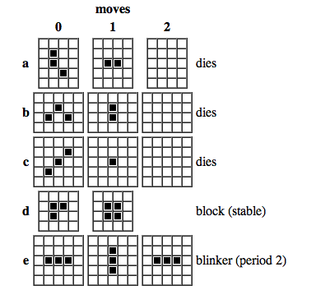

Slide 40
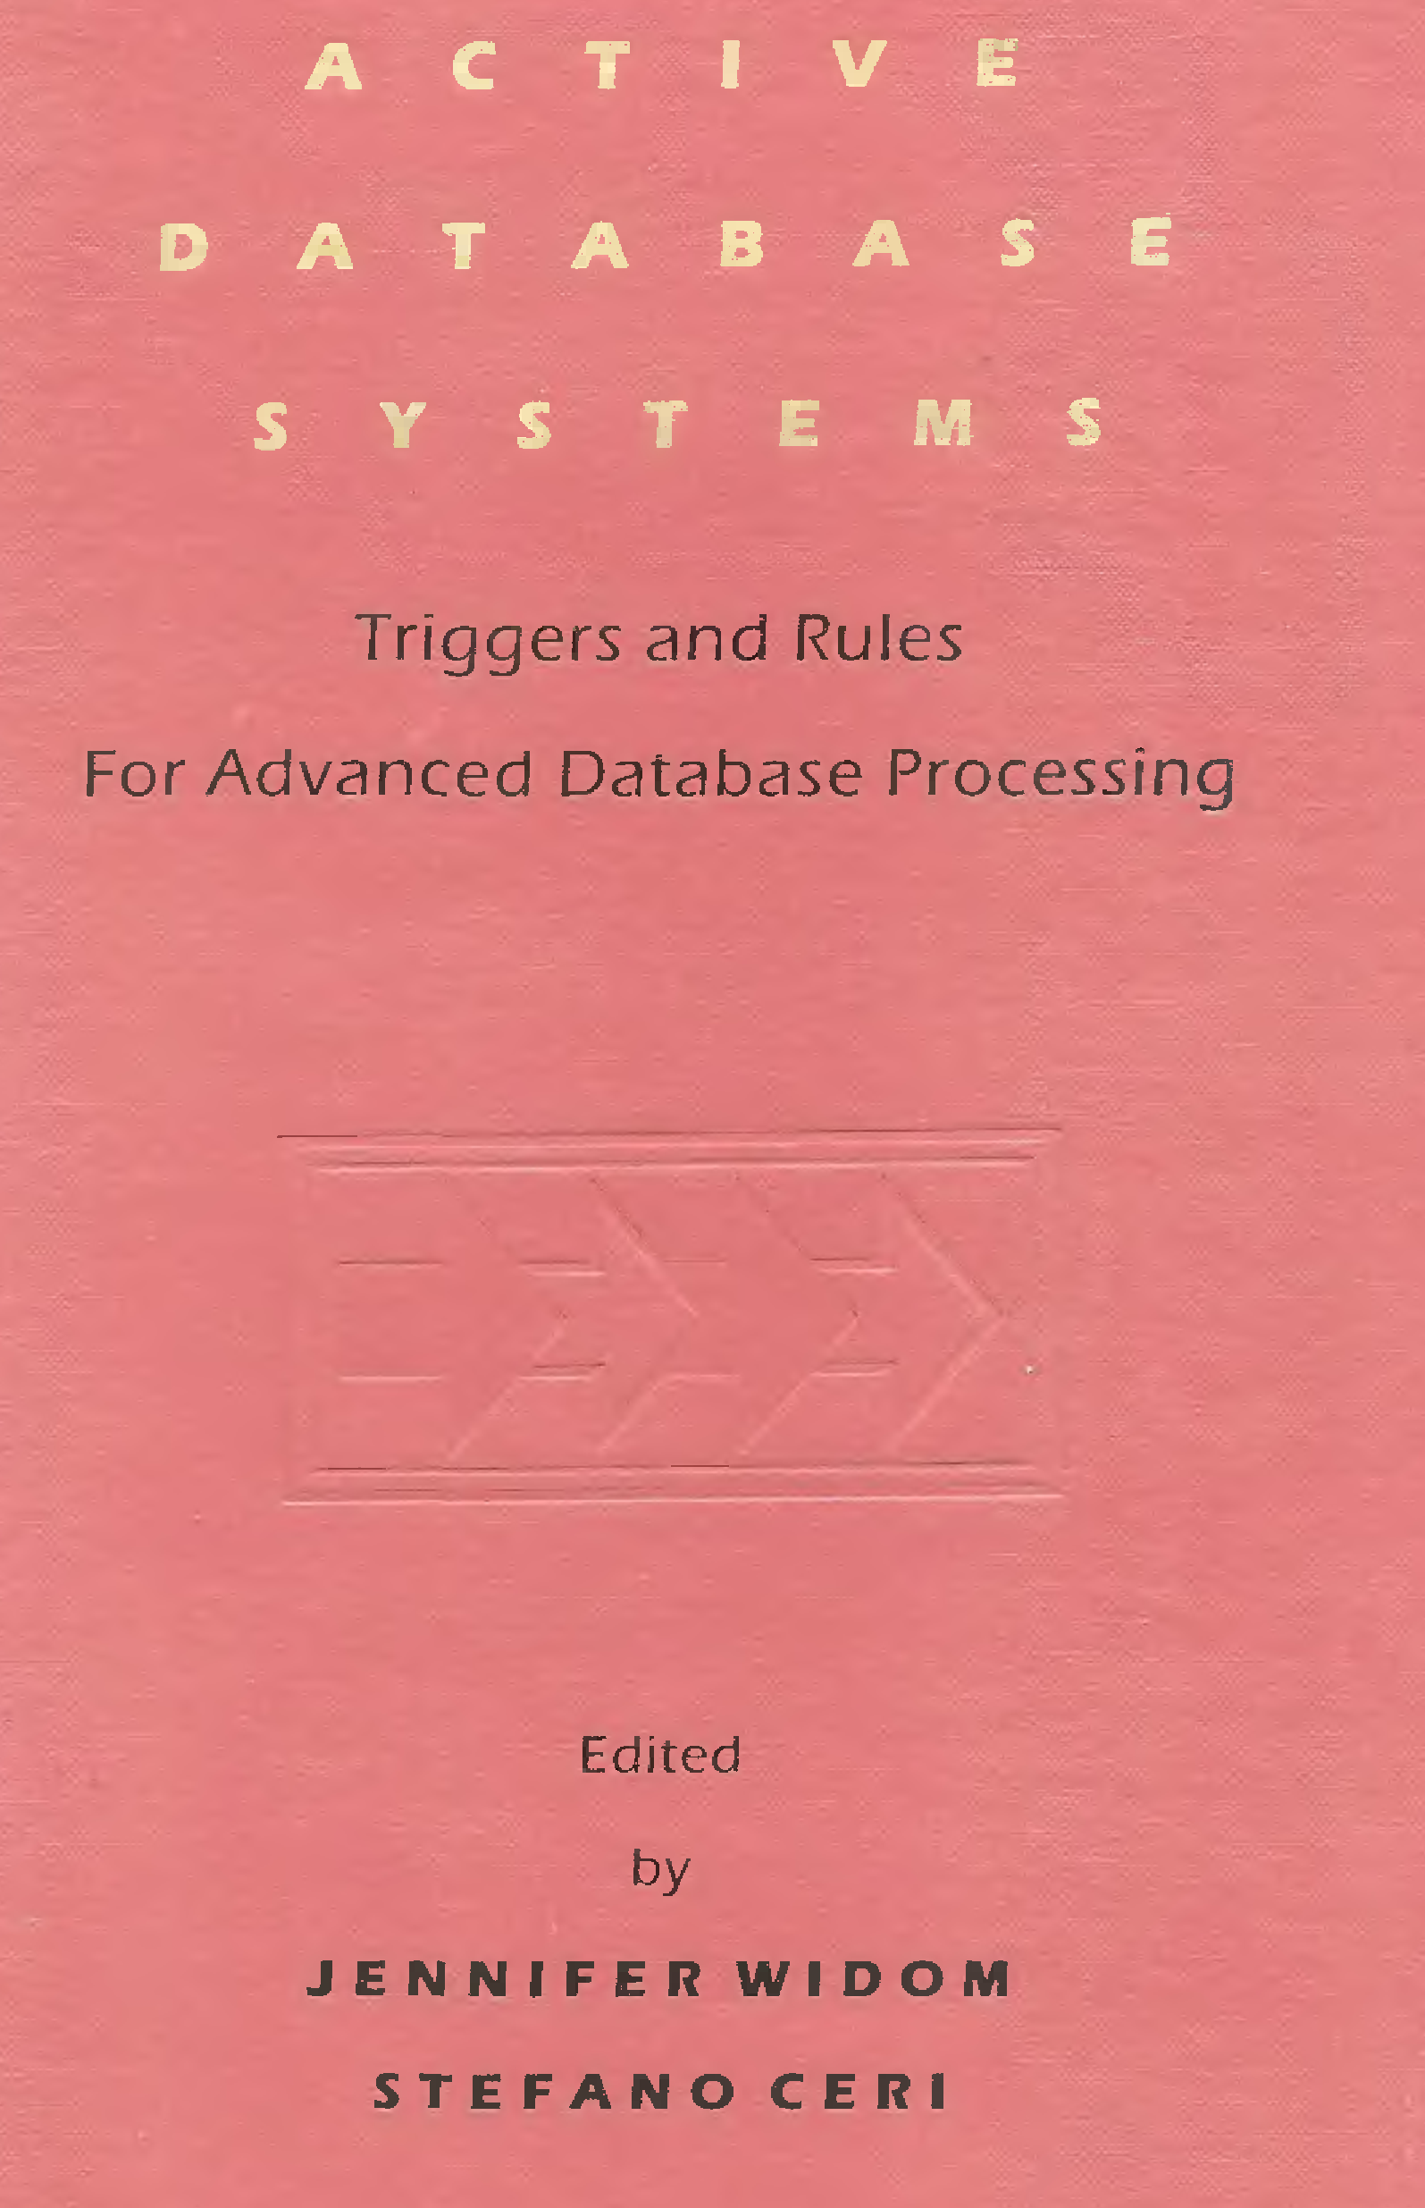
Two kinds of database systems: Active Databases and
Deductive Databases (e.g. Datalog)

Slide 41
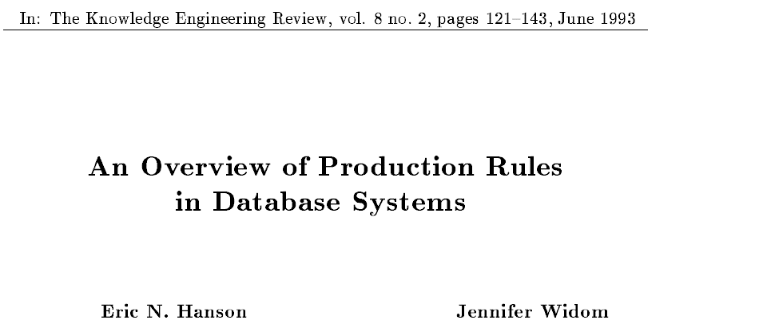
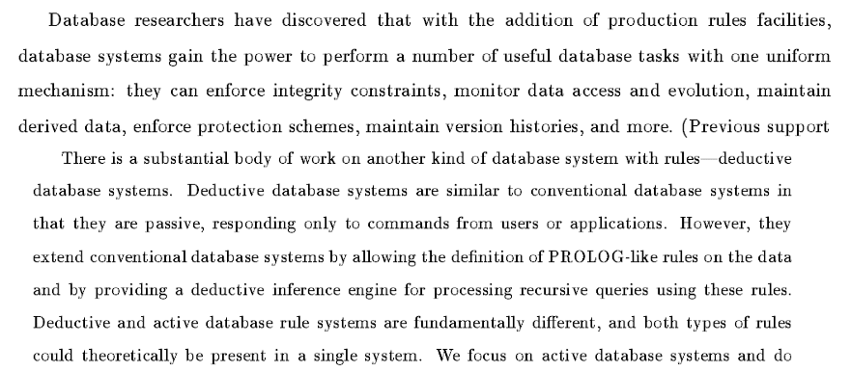

Slide 42
The distinction between goals and beliefs is fundamental in database systems
From Datalog± (including ontologies and integrity constraints; Cali, Gottlob, Lukasziewicz; 2009, example 2.
Datalog rules = beliefs
manager(X) → employee(X)
Integrity constraints = goals
manager(X) → ∃Y supervises(X, Y )
employee(X), employer(X) → false
supervises(X, Y ), supervises(X′, Y ) → X = X′

Slide 43
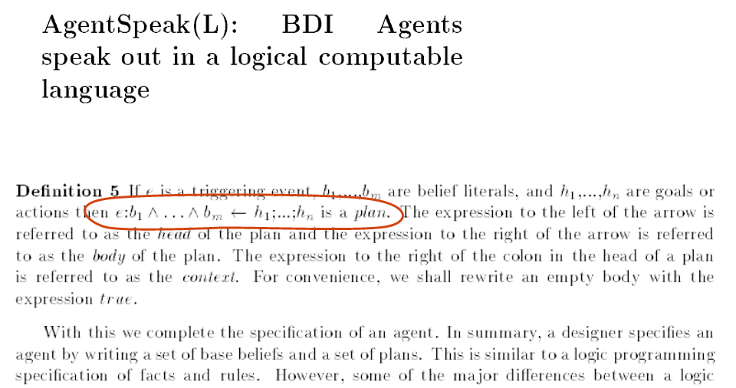
Reactive rules and logic programs:
It can be hard to tell the difference

Slide 44

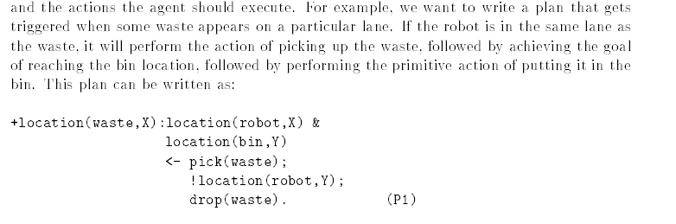
LPS and BDI agents compared
This “logic programming-like” plan in AgentSpeak
is a reactive rule (or goal) in LPS:
if location(waste, X) at T1, location(robot, X) at T1, location(bin, Y) atT1
then pick(waste) fromT1 to T2,
move-to-location(robot, Y) fromT2 to T3,
drop(waste) from T3 to T4.

Slide 45
The distinction between goals and beliefs is the foundation of SBVR
SBVR – From Wikipedia:
“The Semantics of Business Vocabulary and Business Rules (SBVR) is an adopted standard of the Object Management Group (OMG) intended to be the basis for formal and detailed natural language declarative description of a complex entity, such as a business. “
From Baisley, Hall and Chapin:
“Distinguishing between
guidance (rules that people break) and
structural rules (rules about meaning)
is very important in understanding business rules.”

Slide 46
SBVR - Example from Baisley, Hall and Chapin
It is obligatory that each person on a bus has a ticket.
A person on a bus either has a ticket or is breaking the rule.
It is logically necessary that each person on a bus has a ticket.
Being on a bus implies that there is a ticket.
These modalities are not nested as in normal modal logic.
LPS as an alternative to modal logic:
Goal: if a person is on a bus then the person has a ticket.
Belief: a person has a ticket if the person is on a bus.

Slide 48
Claims
LPS gives a simple logic to
reactive rules
destructive updates
LPS is a simple alternative to
modal logics of time, necessity and obligation.

Slide 49
Overview
Introduction
LPS examples
LPS in relation to computer science
LPS implementation
Foundations of LPS and related work

Slide 50
Overview
Introduction
LPS examples
LPS in relation to computer science
LPS implementation
Foundations of LPS and related work

Slide 51
Foundations of LPS and related work
Theorist
Abductive Logic Programming (ALP)
Related Frameworks
LPS can be extended

Slide 52
Theorist - Poole, D., Goebel, R. & Aleliunas, R. (1987).
A theorist framework is a pair ⟨P, A⟩ where
P FOL theory.
A sentences representing candidate assumptions.
Given a goal G, the task is to generate some Δ ⊆ A such that:
P ∪ Δ logically implies G and
P ∪ Δ is consistent.
Poole, D. (1988). A logical framework for default reasoning. Artificial intelligence.
Assumptions A can be default assumptions.

Slide 53
Abductive Logic Programming (ALP)
An abductive framework is a triple ⟨P, I, A⟩ where
P logic program.
I integrity constraints.
A atomic sentences.
Given a goal G, the task is to generate some Δ ⊆ A such that:
P ∪ Δ solves G
P ∪ Δ satisfies I.
There can be many such Δ.
it may be required to generate the best Δ possible.
In applications to abduction Δ explains observations G.
In planning Δ is a plan to achieve G.
In default reasoning Δ is a set of defeasible assumptions.

Slide 54
ALP alternative semantics
What does “P ∪ Δ solves G” mean?
G is a theorem logically implied by the completion of P ∪ Δ ?
G is true in the intended/standard model of P ∪ Δ?
What does “P ∪ Δ satisfies I” mean?
I is consistent with P ∪ Δ?
I is consistent with the completion of P ∪ Δ?
I is true in the intended/standard model of P ∪ Δ?
In LPS there is no difference between G and I:
G and I are both true in the intended/standard model of P ∪ Δ.

Slide 55
LPS is an instance of a more general, simplified variant of ALP
An abductive framework is a triple ⟨P, G, A⟩ where
P logic program.
G sentences in FOL.
A atomic sentences.
The task is to generate some Δ ⊆ A such that:
G is true in the intended/standard model M of P ∪ Δ.
If P is a set of Horn clauses,
then the intended/standard model M of P ∪ Δ
is the unique minimal model of P ∪ Δ.
Advantages of the simplified semantics:
G can be an arbitrary set of FOL sentences (+aggregation operators).
Δ can be infinite.
This is like the standard model of arithmetic (defined by Horn clauses)
compared with first-order axioms for arithmetic.

Slide 56
LPS is an instance of the simplified variant of ALP
An LPS framework is a triple ⟨P, G, A⟩ where
P logic program.
G reactive rules and constraints.
A atomic sentences.
The task is to generate some Δ ⊆ A, such that:
G is true in the intended/standard model M of P ∪ F ∪ Δ
where F is a set of frame axioms.
Δ can be generated destructively without using F.
But F is true in M.
There can be many such Δ.
It is often desirable to generate the best Δ possible.
In the current implementation,
the only way to indicate that one Δ is better than another Δ
is indirectly by ordering clauses.
Or by introducing extra conditions into clauses and rules.

Slide 57
Related frameworks
FO(ID) - Denecker, M. (2000). Extending classical logic with inductive definitions. Computational Logic—CL 2000
SCIFF - Alberti, M., Gavanelli, M., Lamma, E., Mello, P., Torroni, P. & Sartor, G. (2006). Mapping deontic operators to abductive expectations.
MetaTem - Barringer, H., Fisher, M., Gabbay, D., Owens, R. and Reynolds, M. (1996). The imperative future: principles of executable temporal logic. John Wiley & Sons.
Transaction Logic - Bonner, A. and Kifer, M. 1993.Transaction logic programming. In Logic Programming: Proc. of the 10th International Conf.
CHR - Frühwirth, T. 2009. Constraint Handling Rules. Cambridge University Press.

Slide 58
FO(ID) - Denecker, M. (2000). Extending classical logic with inductive definitions.
Combines
classical (non-Herbrand) logical consequence for FOL with
well-founded semantics for logic programs.

Slide 59
SCIFF - Alberti, M., Gavanelli, M., Lamma, E., Mello, P., Torroni, P. & Sartor, G. (2006). Mapping deontic operators to abductive expectations.
An ALP framework is ⟨P, I, A⟩ where
given G, the task is to generate some Δ ⊆ A, such that:
the completion of P ∪ Δ logically implies G ∪ I.
SCIFF extends the IFF proof procedure of Fung and Kowalski 1997.
Assumptions can be
positive expectations of actions that ought to happen negative expectations of actions that ought not to happen.

Slide 60
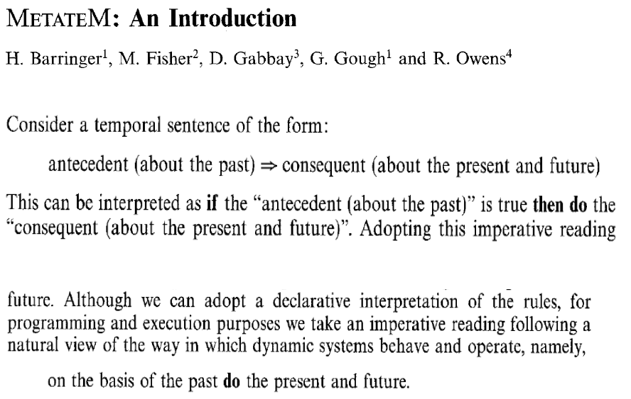


Slide 61
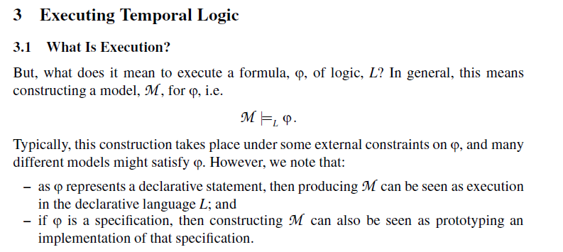

Computation in MetateM is model generation
MetaTem uses frame axioms to generate possible worlds
simulates logic programs by reactive rules.

Slide 62
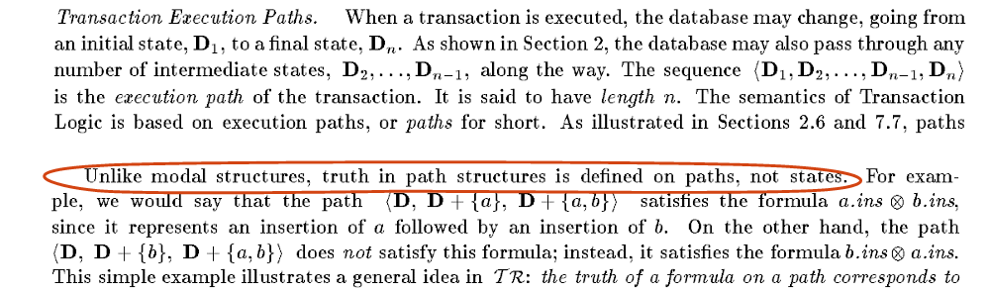
Transaction logic programming – Bonner and Kifer 1993.
Deductive databases as data structures.
The operational semantics performs destructive updates to a current state.
Reactive rules can be programmed/simulated.

Slide 63
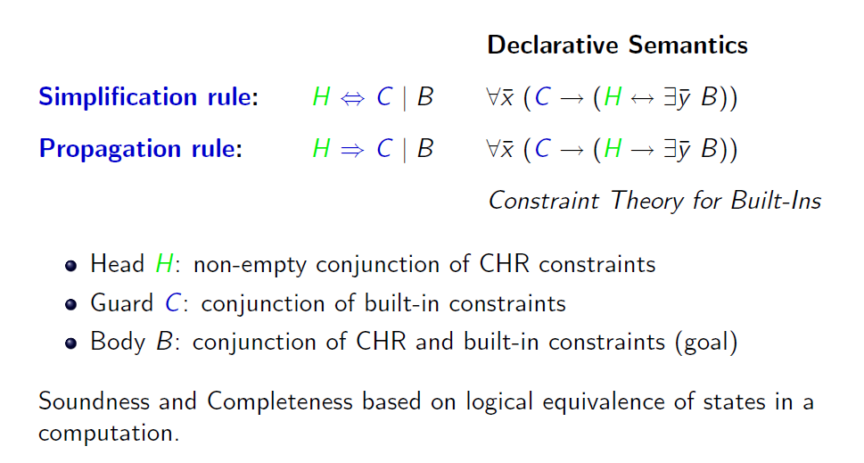
CHR - Frühwirth, T., 2006,
Constraint handling rules: the story so far.

Slide 64
CHR compared with LPS
Propagation rules can simulate production rules.
Linear logic semantics can simulate destructive updates.

Slide 65
Conclusion
LPS is a declarative, human-oriented language
with an imperative interpretation.
Logic programs = beliefs
as in LogicBlox and Google (Yedalog)
Reactive rules = goals
as in production systems
Destructive change of state
as in the real world

Slide 66
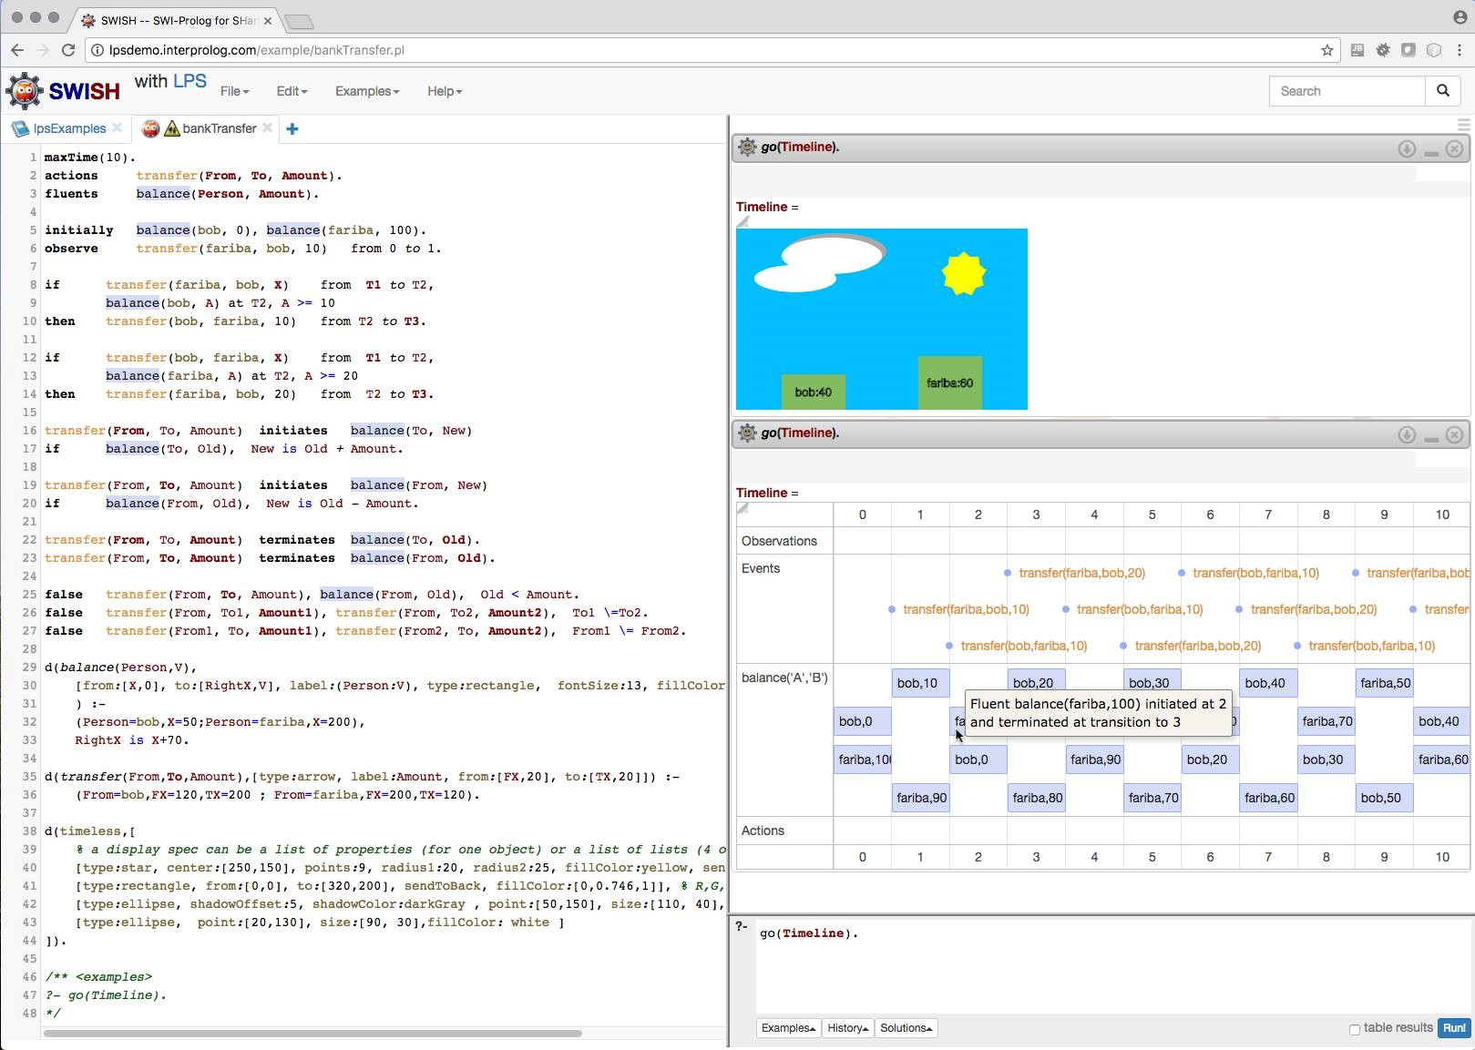
Try it!

Slide 67
The End

Slide 68
Thank You

